Slide 1
Software Engineering
CE 2450
Instructor: Dr. Jingpeng Tang
Notes:
Note that the book is misleadingly simple.
Just reading the book is like learning to swim without getting wet.

Slide 2
Therac-25
Therac-25
Race condition
8 seconds
Notes:
This was the maiden flight of the Ariane 5.
The Inertial Reference System determines the position of the rocket and its movements in space. It has its own computer, which computes angles and speeds based on information it gets from the ground station, lasers, etc. There are 2 IRS’s, which both failed.

Slide 3
ARIANE Flight 501
Disintegration after 39 sec
  Overflow in conversion from 64-bit floating point to 16-bit signed integer
  $500M loss
Notes:
This was the maiden flight of the Ariane 5.
The Inertial Reference System determines the position of the rocket and its movements in space. It has its own computer, which computes angles and speeds based on information it gets from the ground station, lasers, etc. There are 2 IRS’s, which both failed.

Slide 4
Possible explanations
Inadequate testing
Wrong type of reuse
Wrong design philosophy
Notes:
In a sense, all these explanations are true
This shows the complexity of issues, and the trade-offs involved

Slide 5
Inadequate testing?
Specification does not contain Ariane 5 trajectory data as a functional requirement
In tests, the SRI’s (components that measure altitude and movements of the launcher) were simulated by software modules
Notes:
- you can’t really test an SRI without a real flight
- it could be done with a simulation, but not in real time because of the computations involved
- the SRI was not in the main loop of the simulation
- later, the inquiry team did those simulations, and caught the error

Slide 6
Improper reuse?
If a component works perfectly well in one environment, it doesn’t necessarily do so in another
Ariane 5 is much faster than Ariane 4
Software runs for a while after lift-off. It doesn’t have any purpose for the Ariane 5, but was still kept
Notes:
- the error was in a piece of software which really has no purpose after take-off
- if the count-down stops, certain things happen, and resetting then takes 45 minutes
- if this particular piece of software runs for a little longer than really needed, a quick restart (of the Ariane 4) is possible and the 45 minutes are saved. This indeed occurred on one Ariane 4 flight
- though this does not apply in the Ariane 5 case, the software was left intact (the rule being “if it works, do not tinker with it”)

Slide 7
Wrong design philosophy?
If something breaks down, such is caused by a random hardware failure
Action: shut down that part
There is no provision for design errors
Notes:
- in hardware, when something breaks down, there isn’t much you can do
- in software you can; e.g. ask for the best possible answer

Slide 8
Software engineering
The beginning
1968/69 NATO conferences: introduction of the term Software Engineering
Idea: software development is not an art, or a bag of tricks
Build software like we build bridges

Slide 9

Building a bridge

Slide 10
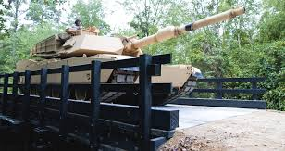
Building a bridge

Slide 11
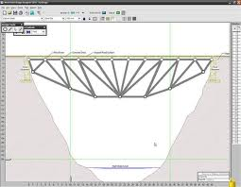
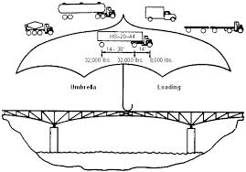
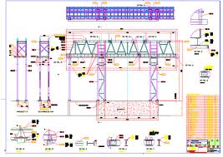
Building a bridge

Slide 12
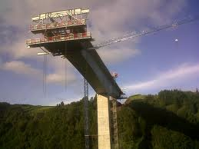
Building a bridge

Slide 13
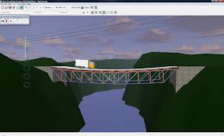
Building a bridge

Slide 14

Building a bridge

Slide 15
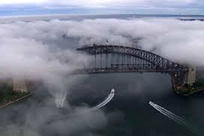
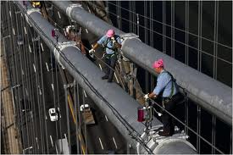
Building a bridge

Slide 16
Current status
a lot has been achieved
but …
some of our bridges still collapse
Notes:
What has been achieved: Space Shuttle software, international money transfers, Deep Blue (chess program), e-commerce businesses, etc.
Other example: when you get an accident in a modern expensive car, the computer in the airbag phones some emergency server, which in turn phones the cellular phone in the car. If this call is not answered within 10 seconds, the position of the car is determined, and the police and ambulance are warned and given the coordinates of the accident.

Slide 17
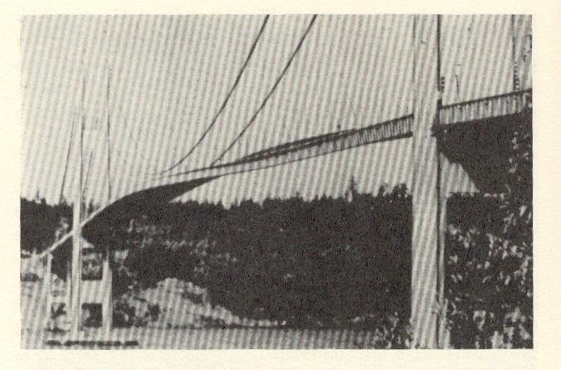
Tacoma Narrows bridge

Slide 18
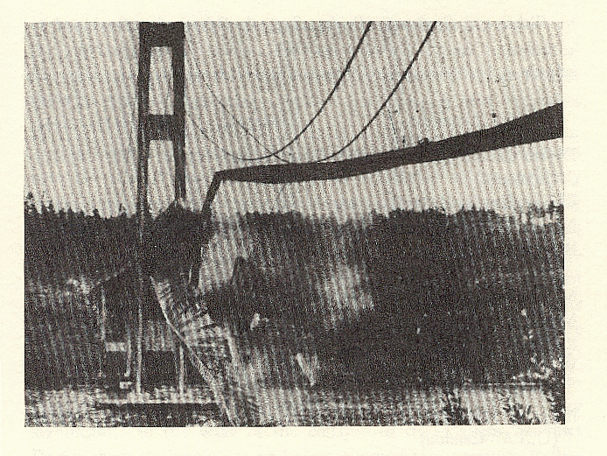
Same bridge, a while later

Slide 19
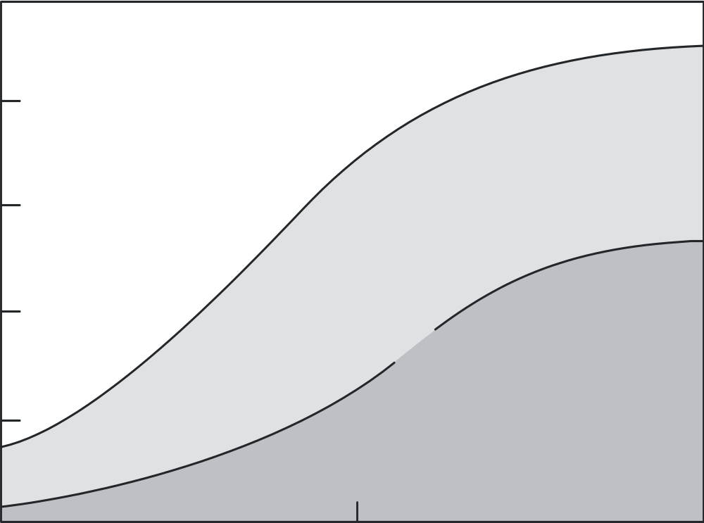
Relative distribution of software/hardware costs
100
Hardware
Development
60
Percent of total cost
Software
20
Maintenance
1955
1970
1985
Year

Slide 20
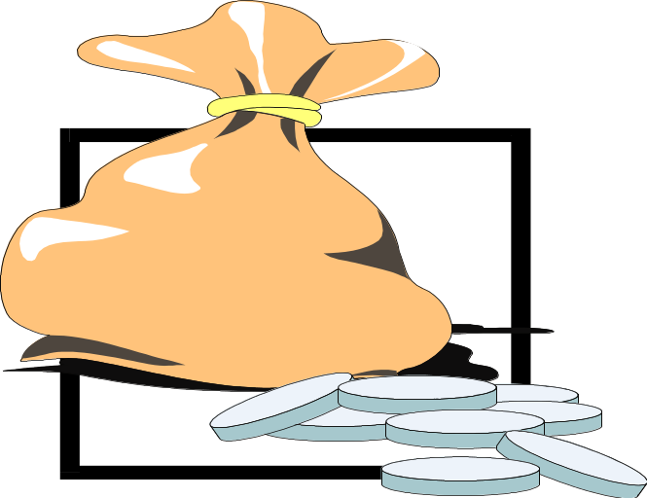
Point to ponder #1
Why does software maintenance cost so much?

Slide 21
Definition (IEEE)
Software Engineering is the application of a systematic, disciplined, quantifiable approach to the development, operation, and maintenance of software; that is, the application of engineering to software.
And the study of it.

Slide 22
Central themes
SE is concerned with BIG programs
complexity is an issue
software evolves
development must be efficient
you’re doing it together
software must effectively support users
involves different disciplines
SE is a balancing act
Notes:
- Space Shuttle software: 40 million lines of code
- complexity often is not “mathematical” complexity, but caused by the myriad of details to be handled
- reality changes, so the software has to change as well (e.g. salary administration and changing tax regulations)
- software costs a tremendous amount of money (it is very labor intensive)
- OS 360 cost 5000 person years (so you need rules and regulations - hence process models)
- so user involvement
- software engineers tend to have little knowledge of the application domain

Slide 23
Building software ~ Building bridges?
yes, and no
software changes a lot
software is logical, rather than physical
progress is hard to see (speed ≠ progress)
software is not continuous
Notes:
- cost is in development, not in production
- there is no wear and tear. Software deteriorates because it is maintained
- mathematical proofs rather than engineering safety margins
- progress is hard to see (Boehm’s tale: after delivering software for a fighter plane, one of the officers asks how much the software weighs. Answer: nothing. The officer does not believe this, and after a while he comes back with a pile of punched cards. Says: see how much this weighs. Boehm answers: but we only sell the holes.)
- software is not continuous, so extrapolation is tricky (see Tacoma bridge example).

Slide 24
Simple life cycle model
problem
requirements engineering
reqs specification
design
Tech specification
implementation
program
testing
working system
maintenance

Slide 25
Point to ponder #2
Is this a good model
of how we go about?
of how we should go about?
Notes:
- backtracking is needed: you do not know everything, make errors, users change their mind, etc.
- designers/implementers go about in a yo-yo fashion; they go from the global level to a very detailed study (e.g. to solve or investigate some local problem) and then go back to the global level again.

Slide 26
Requirements Engineering
yields a description of the desired system:
  which functions
  possible extensions
  required documentation
  performance requirements
includes a feasibility study
resulting document: requirements specification
Notes:
- the requirements document often has a legal status too.
- different stakeholders want different documents (the designer/impementer wants a precise, formal document, while the user is best served by a document in her natural language)
- it is important the the requirements document is very precise; no TBD’s (To Be Determined). If you do not know what is being asked, chances are you will not come up with the right answer.

Slide 27
Design
earliest design decisions captured in software architecture
decomposition into parts/components; what are the functions of, and interfaces between, those components?
emphasis on what rather than how
resulting document: design specification
Notes:
“my” law: The sooner you start coding, the longer it takes

Slide 28
Implementation
focus on individual components
goal: a working, flexible, robust, … piece of software
not a bag of tricks
present-day languages have a module and/or class concept
Notes:
Pareto’s law generally holds here as well; so most local work on efficiency is a waste of time. It makes the software more complex, less portable, less reusable, and more error-prone.
At this stage too, documentation and communication is very important. Undocumented decisions fire back.

Slide 29
Testing
does the software do what it is supposed to do?
are we building the right system? (validation)
are we building the system right? (verification)
start testing activities in phase 1, on day 1
Notes:
Testing should not start after the implementation phase.
Cleanroom development: developers are allowed to read the programs they’ve written, they are not allowed to execute them. Testing in Cleanroom is done by others.
Question to students: do you dare to give a warranty on the software you wrote?

Slide 30
Maintenance
correcting errors found after the software has been delivered
adapting the software to changing requirements, changing environments, ...
SE, Introduction, Hans van Vliet, ©2008
Notes:
- IBM OS 360: 1000 errors per release, and this number did not really go down over time
- quick and dirty bug fixes increase the system’s entropy
- maintenance is usually done under pressure

Slide 31
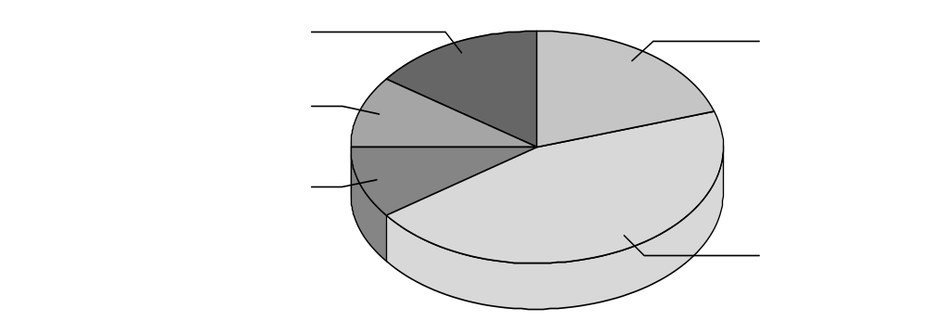
Global distribution of effort
design 15%
coding 20%
requirements
engineering 10%
specification 10%
testing 45%

Slide 32
Global distribution of effort
rule of thumb: 40-20-40 distribution of effort
trend: enlarge requirements specification/design slots; reduce test slot
beware: maintenance alone consumes 50-75% of total effort

Slide 33
Kinds of maintenance activities
corrective maintenance: correcting errors
adaptive maintenance: adapting to changes in the environment (both hardware and software)
perfective maintenance: adapting to changing user requirements
Preventive maintenance: increasing the future maintainability
Notes:
- adaptive maintenance does not change the functionality of the system
- people often have trouble distinguishing between adaptive and perfective maintenance
- since most present-day development does not start from scratch, part of maintenance resembles development: both concern the evolution of a system; see also exercise 10 of chapter 14.

Slide 34
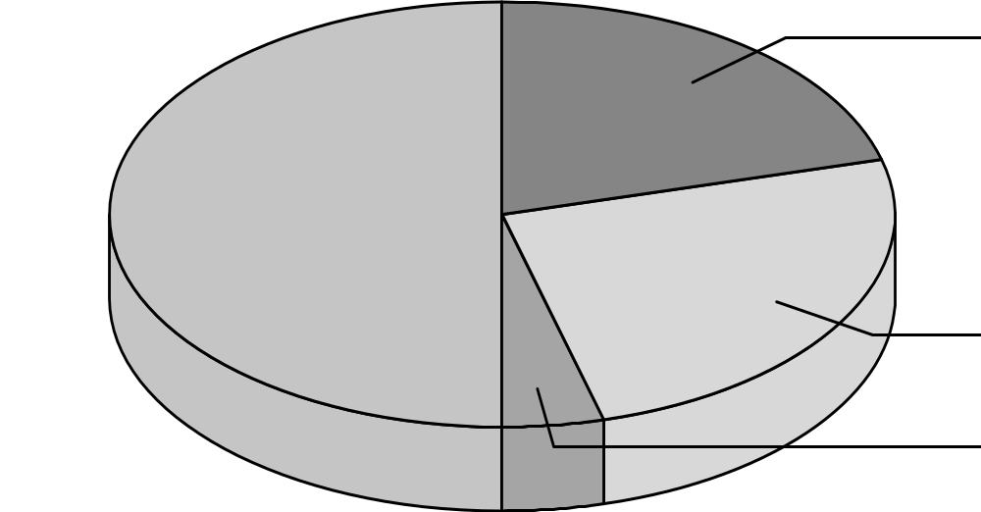
Distribution of maintenance activities
corrective 21%
perfective 50%
adaptive 25%
preventive 4%

Slide 35
Point to ponder #3
You are a tester, and the product you are testing does not yet meet the testing requirements agreed upon in writing. Your manager wants to ship the product now, continue testing so that the next release will meet the testing requirements. What do you do?
Discuss the issue with your manager?
Talk to the manager’s boss?
Talk to the customer?

Slide 36
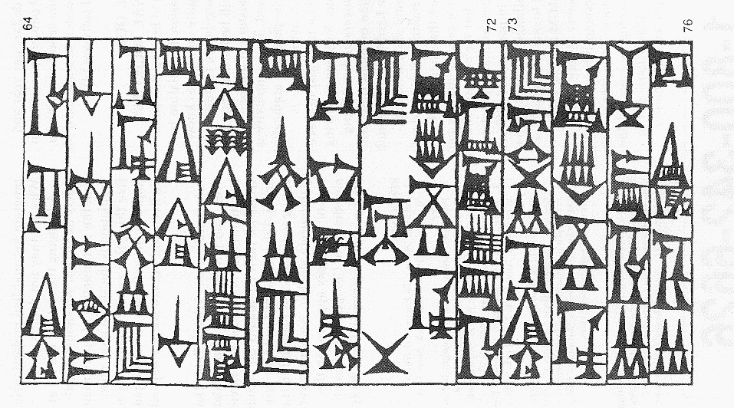
Hammurabi’s Code of Mesopotamia

Slide 37
Hammurabi’s Code (translation)
64: If a builder build a house for a man and do not make its construction firm, and the house which he has built collapse and cause the death of the owner of the house, that builder shall be put to death.
73: If it cause the death of a son of the owner of the house, they shall put to death a son of that builder.

Slide 38
Software Engineering Ethics - Principles
Act consistently with the public interest
Act in a manner that is in the best interest of the client and employer
Ensure that products meet the highest professional standards possible
Maintain integrity in professional judgment
Managers shall promote an ethical approach
Advance the integrity and reputation of the profession
Be fair to and supportive of colleagues
Participate in lifelong learning and promote an ethical approach
Notes:
- result of a joint effort of ACM and IEEE
- see also http://computer.org/tab/seprof/code.htm

Slide 39
Quo Vadis?
It takes at least 15-20 years for a technology to become mature; this also holds for computer science: UNIX, relational databases, structured programming, …
Software engineering has made tremendous progression
There is no silver bullet, though
Notes:
The “silver bullet”stems from Frederic Brooks seminal article “No Silver Bullet: Essence and Accidents of Software Engineering”, IEEE Computer 20, 4 (1987), pp 10-20.

Slide 40
Recent developments
Rise of agile methods
Shift from producing software to using software (CBSD, COTS)
Success of Open Source Software
Software development becomes more heterogeneous

Slide 41

The Agile Manifesto
Individuals and interactions over processes and tools
Working software over comprehensive documentation
Customer collaboration over contract negotiation
Responding to change over following a plan
Notes:
Agility: readiness for motion”, “nimbleness” (= behendigheid”)

Slide 42
Producing software ⇒ Using software
Builders build pieces, integrators integrate them
Component-Based Software Development (CBSD)
Software Product Lines (SPL)
Commercial Off-The-Shelves (COTS)
Service Orientation Architecture (SOA, SaaS, PaaS, IaaS)

Slide 43
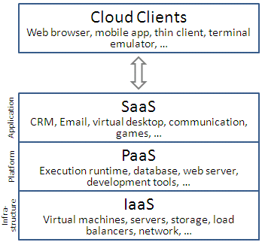
Producing software ⇒ Using software

Slide 44
Open Source: crowdsourcing
McDonald’s vs Chinese Restaurant
No requirements engineers needed!
Gives rise to new business model

Slide 45
Heterogeneity
Old days: software development department had everything under control
Nowadays:
  Teams scattered around the globe
  Components acquired from others
  Includes open source parts
  Services found on the Web

Slide 46
Point to ponder #4
Which of the following do you consider as Software Engineering Principles?
  Build with and for reuse
  Define software artifacts rigorously
  Establish a software process that provides flexibility
  Manage quality as formally as possible
  Minimize software components interaction
  Produce software in a stepwise fashion
  Change is inherent, so plan for it and manage it
  Tradeoffs are inherent, so make them explicit and document them
  Uncertainty is unavoidable, so identify and manage it
Notes:
See exercise 17 of chapter 1.
Many of the issues addressed are discussed extensively in later chapters.

Slide 47
SUMMARY
software engineering is a balancing act, where trade-offs are difficult
solutions are not right or wrong; at most they are better or worse
most of maintenance is (inevitable) evolution
there are many life cycle models, and they are all models

